Slide 1
CSE 4513
Introduction to SW Engineering
Lec - 1

Slide 2
Classroom Rules
BE ON TIME
BE A GOOD LISTENER
ASK QUESTIONS
SHARE NEW IDEAS
CONTRIBUTE TO DISCUSSIONS

Slide 3
Google Classroom Info
Join using Class Code
ik43qgo
Join using Invitation link
https://classroom.google.com/c/NjE2Njg2ODQ4MTQ1?cjc=ik43qgo
Use only IUT email to join

Slide 4
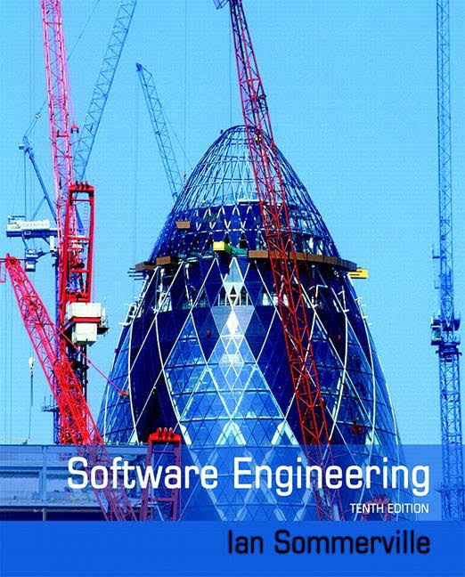
Important For you
Course Code: CSE 4513
Course Name: Software Engineering and Object-Oriented Design
Textbook:
Software Engineering a practitioner’s approach, Author: Roger S. Pressman Fourth edition, McGraw-Hill Book Company
Object Oriented Modeling and Design, Author: Raumbugh
Unified Modeling system, Author: Raumbugh
Applying UML and Patterns, Author: Craig larman
Object oriented analysis and design Using UML Author: Bennet Farmer
Design Pattern, Author: Gamma, Helm & Jhonson

Slide 5
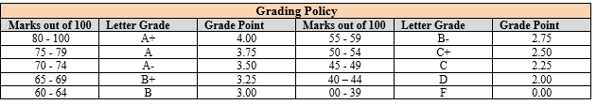
Assessment & Grading Policy
Course Assessment Method
Attendance (10%) | Quiz 15% of Total Marks (Best 3 out of 4) | Mid Semester (25%) | Semester Final (50%)

Slide 6
Course Objective
Upon completion of this course, you will be familiar with:
01
the process of requirement analysis, designing, implementing and maintaining of Software systems.
02
The concept of Object-Orientation, Design patterns and its importance
03
the testing approaches and quality assurance to ensure high standard/professional software.

Slide 7
Course Outcome(CO)
CO1
Understand the fundamentals of software development process.
CO2
Asses the SW requirements and applying appropriate design techniques to build SW systems.
CO3
Demonstrate an ability to use the techniques and tools for to release and maintain quality software.

Slide 8
Outcome Based Education (OBE)
Exam Result is Not the Most Important Consideration by Employer
Communication (verbal & written)
Honesty/Integrity
Teamwork skills
Interpersonal skills
Strong work ethics
Motivation & initiative
Flexibility/adaptability
Analytical skills
Computer skills
Creativity
Organizational skills
Detail oriented
Leadership skills
Self confidence
Friendly/outgoing personality
Well mannered / polite
Tactfulness
CGPA (3.0 or better)
Sense of humor
Entrepreneurial skills/risk taker

Slide 9
Outcome Based Education (OBE)
Course outcomes (COs) identify what the learner will know and be able to do by the end of a course or program.
Program Outcomes(POs) are narrower statements that describe what students are expected to know and be able to do by the time of graduation.
PO-1 | Engineering knowledge: Apply the knowledge of mathematics, science, engineering fundamentals and an engineering specialization to the solution of complex engineering problems.
PO-2 | Problem analysis: Identify, formulate, research and analyze complex engineering problems and reach substantiated conclusions using the principles of mathematics, the natural sciences and the engineering sciences.
PO-3 | Design/development of solutions: Design solutions for complex engineering problems and design system components or processes that meet the specified needs with appropriate consideration for public health and safety and of cultural, societal and environmental concerns.
PO-4 | Investigation: Conduct investigations of complex problems, considering experimental design, data analysis and interpretation and information synthesis to provide valid conclusions.
PO-5 | Modern tool usage: Create, select and apply appropriate techniques, resources and modern engineering and IT tools, including prediction and modeling, to complex engineering activities with an understanding of their limitations.
PO-6 | The engineer and society: Apply reasoning informed by contextual knowledge to assess societal, health, safety, legal and cultural issues and the consequent responsibilities relevant to professional engineering practice.
PO-7 | Environment and sustainability:Understand the impact of professional engineering solutions in societal and environmental contexts and demonstrate the knowledge of and need for sustainable development.
PO-8 | Ethics: Apply ethical principles and commit to the professional ethics, responsibilities and the norms of the engineering practice.
PO-9 | Individual work and teamwork: Function effectively as an individual and as a member or leader of diverse teams and in multidisciplinary settings.
PO-10 | Communication: Communicate effectively about complex engineering activities with the engineering community and with society at large. Be able to comprehend and write effective reports, design documentation, make effective presentations and give and receive clear instructions.
PO-11 | Project management and finance: Demonstrate knowledge and understanding of engineering and management principles and apply these to one’s work as a team member or a leader to manage projects in multidisciplinary environments.
PO-12 | Life-long learning: Recognize the need for and have the preparation and ability to engage in independent, life-long learning in the broadest context of technological change.

Slide 10
Outcome Based Education (OBE)
Roles of Students
Know the required Programme Outcomes and Programme Objectives
For each course, review the Learning Outcomes at the beginning of each semester. This gives you an idea of the knowledge and skills expected from a particular course.
Be more proactive in the learning process to acquire the Learning Outcomes of subjects.
Demonstrate through the assessment methods that the required skills and knowledge have been acquired.
Give constructive feedbacks on the program/courses

Slide 11
Lecture Plan
Weeks | Topics
1 | Introduction to SW Engineering, SW size estimation, Cost, Schedule & Quality
2 | SW Processes, SW Development Models
3 | SW Requirement Analysis
4 | UI Specification and UI Design
5 | Object modeling Using UML
6 | SW Design, OO Basics, SOLID Principle
7 | SOLID Principle
8 | Design Pattern
9 | Design Pattern
10 | Clean Coding, Debugging and Unit testing
11 | Test Driven development, SW testing
12 | SW Testing
13 | SW configuration Management, Open-Source Compliance
14 | SW release and Maintenance
15 | Review Class

Slide 12
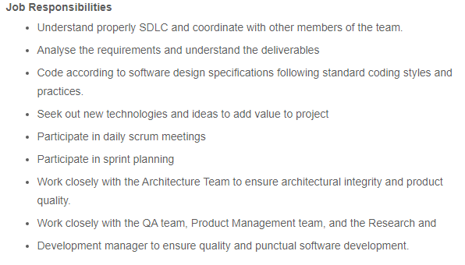
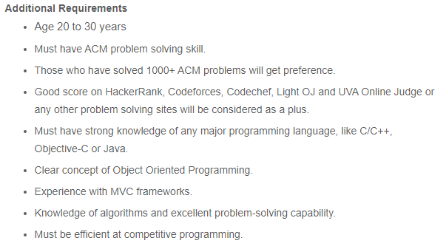
Looking for SW Engineer
Jr. Software Engineer

Slide 13
Why I am here
01
To Help developing your skills that will enable you to develop industry standard software of high quality.
02
To foster an understanding of why these skills are important.

Slide 14
What is Software(SW)
is a set of instructions (computer program) and its associated documentations that tells a computer what to do or how to perform a task.

Slide 15
attributes of good software
Product characteristic | Description
Maintainability | Software should be written in such a way so that it can evolve to meet the changing needs of customers. This is a critical attribute because software change is an inevitable requirement of a changing business environment.
Dependability and security | Software dependability includes a range of characteristics including reliability, security and safety. Dependable software should not cause physical or economic damage in the event of system failure. Malicious users should not be able to access or damage the system.
Efficiency | Software should not make wasteful use of system resources such as memory and processor cycles. Efficiency therefore includes responsiveness, processing time, memory utilisation, etc.
Acceptability | Software must be acceptable to the type of users for which it is designed. This means that it must be understandable, usable and compatible with other systems that they use.

Slide 16
Industry Standard SW
An industry standard SW must be:
Operational
Transitional
Easy to Maintain
Budget
Efficiency
Usability
Dependability
Correctness
Functionality
Security
Interoperability
Reusability
Portability
Adaptability
Flexibility
Maintainability
Modularity
Scalability

Slide 17
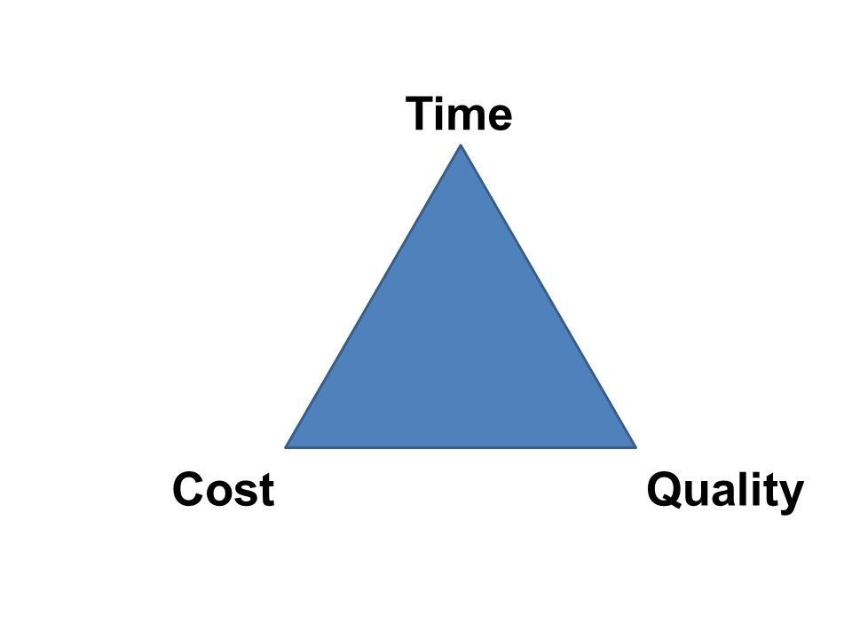
Industry Standard SW
quality, cost, and schedule are the main forces that drive an industry standard software project.
should be produced at reasonable cost, in a reasonable time, and should be of good quality.

Slide 18

What is SW Engineering
Software engineering is defined as a discipline whose aim is the production of quality software, delivered on time and within the budget and that satisfies its requirement.
IEEE, in its standard 610.12-1990, defines software engineering as the application of a systematic, disciplined, which is a computable approach for the development, operation, and maintenance of software.

Slide 19


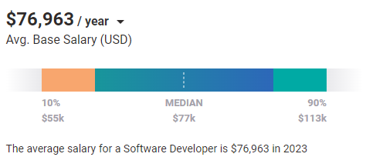
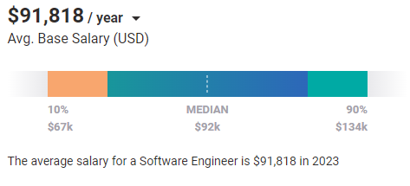
SW Developer(Programmer) vs SW Engineer
Based on 16,538 salary profiles (last updated Jul 26’2023)
Based on 48,807 salary profiles (last updated Jul 26’2023)

Slide 20
Key Difference
Software Engineer applies the principles of software engineering for designing, development, maintenance, testing, and evaluation of computer software whereas Software Developer builds software which runs across various types of computer.
Software Engineer works with other components of the hardware system whereas Software Developers write a complete program.
Software Engineer creates the tools to develop software while Software Developers use readymade tools to build apps.
Software Engineer tends to solve issues on a much larger scale whereas Software Developers tend to do everything that engineers do but on a limited scale.

Slide 21

What is Industry demand?
SW Developer or SW Engineer

Slide 22
Challenges of Software Engineering
In safety-critical areas such as space, aviation, nuclear power plants, etc. the cost of software failure can be massive because lives are at risk.
Increased market demands for fast turnaround time.
Dealing with the increased complexity of software and need for new applications.
"The complexity of software is an essential property, not an accidental one"

Slide 23
Software engineering ethics
ACM/IEEE-CS Joint Task Force on Software Engineering Ethics and Professional Practices.
The Ethical Principles are:
1. PUBLIC - Software engineers shall act consistently with the public interest.
2. CLIENT AND EMPLOYER - Software engineers shall act in a manner that is in the best interests of their client and employer consistent with the public interest.
3. PRODUCT - Software engineers shall ensure that their products and related modifications meet the highest professional standards possible.
4. JUDGMENT - Software engineers shall maintain integrity and independence in their professional judgment.
5. MANAGEMENT - Software engineering managers and leaders shall subscribe to and promote an ethical approach to the management of software development and maintenance.
6. PROFESSION - Software engineers shall advance the integrity and reputation of the profession consistent with the public interest.
7. COLLEAGUES - Software engineers shall be fair to and supportive of their colleagues.
8. SELF - Software engineers shall participate in lifelong learning regarding the practice of their profession and shall promote an ethical approach to the practice of the profession.
https://ethics.acm.org/code-of-ethics/software-engineering-code/

Slide 24
SW Process

Slide 25
SW Process
software process is a set of activities that leads to the production of a software product.
There is no ideal process, and many organizations have developed their own approach to software development.
For some systems, such as critical systems, a very structured development process is required. For business systems, with rapidly changing requirements, a flexible, agile process is likely to be more effective.
fundamental activities that are common to all software processes:
1. Software specification The functionality of the software and constraints on its operation must be defined.
2. Software design and implementation The software to meet the specification must be produced.
3. Software validation The software must be validated to ensure that it does what the customer wants.
4. Software evolution - The software must evolve to meet changing customer needs.

Slide 26
SW Size Estimation

Slide 27
SW Size Estimation
Software size is an important metric to be used for various purposes during SE dev projects
Difficult to Measure
Various approaches are used to measure SW size
LINE OF CODE ( LOC)
TOKEN COUNT ( HALSTEAD PRODUCT METRICS)
FUNCTION POINT ANALYSIS (FPA)

Slide 28
SW Size Estimation
LINE OF CODE ( LOC)
This metric is based on the number of lines of code present in the program.
The lines of code are counted to measure the size of a program.
The comments and blank lines are ignored during this measurement.
The LOC metric is often presented on thousands of lines of code ( KLOC).

Slide 29
SW Size Estimation
LINE OF CODE ( LOC)
This metric is based on the number of lines of code present in the program.
The lines of code are counted to measure the size of a program.
The comments and blank lines are ignored during this measurement.
The LOC metric is often presented on thousands of lines of code ( KLOC).

Slide 30
SW Size Estimation
TOKEN COUNT ( HALSTEAD PRODUCT METRICS)
LOC is not consistent, because all lines of code are not at the same level..
Some lines are more difficult to code than others.
Halstead stated that any software program could be measured by counting the number of operators and operands.
From these set of operators and operands, he defined several formulae to calculate the vocabulary, the length, and the volume of the software program.

Slide 31
SW Size Estimation
TOKEN COUNT ( HALSTEAD PRODUCT METRICS)
Halstead Metric
Program Vocabulary
It is the number of unique operators plus the number of unique operands as given below:
n = n1 + n2
where n = program vocabulary
n1 = number of unique operators
n2 = number of unique operands

Slide 32
SW Size Estimation
TOKEN COUNT ( HALSTEAD PRODUCT METRICS)
Halstead Metric
Program Length
It is the total usage of all the operators and operands appearing in the implementation.
N = N1 + N 2
where N = program length
N1 = all operators appearing in the implementation
N2 = all operands appearing in the implementation

Slide 33
SW Size Estimation
TOKEN COUNT ( HALSTEAD PRODUCT METRICS)
Few Halstead Metric
Program Volume
The volume refers to the size of the program and it is defined as the program length times the logarithmic base 2 of the program vocabulary.
V = N log₂ n
where V = program volume
N = program length
n = program vocabulary

Slide 34
SW Size Estimation
FUNCTION POINT ANALYSIS (FPA)
It is based on the idea that the software size should be measured according to the functionalities specified by the user.
Therefore, FPA is a standardized methodology for measuring various functions of a software from the user’s point of view.
The size of an application is measured in function points.

Slide 35
SW Size Estimation
FUNCTION POINT ANALYSIS (FPA)
What do Function Point measure?
X
Functional Requirements
Data Transfer
Storage
Data processing
Retrieval and representation
Requirements
X
Nonfunctional Requirements
Quality
Reliability
Usability
Performance
Security
Project Requirements
Milestones
Budgets
Dependencies
resources

Slide 36
SW Size Estimation
FUNCTION POINT ANALYSIS (FPA)
Process used to calculate the function points
1. Determine the type of project for which the function point count is to be calculated. For example, development project (a new project) or enhancement project.
2. Identify the counting scope and the application boundary.
3. Identify data functions (internal logical file and external interface files) and their complexity.
4. Identify transactional functions (external inputs, external outputs, and external queries) and their complexity.
5. Determine the unadjusted function point count (UFP).
6. Determine the value adjustment factor (VAF), which is based on 14 general system characteristics (GSCs).
7. Calculate the adjusted function point count (AFP).

Slide 37
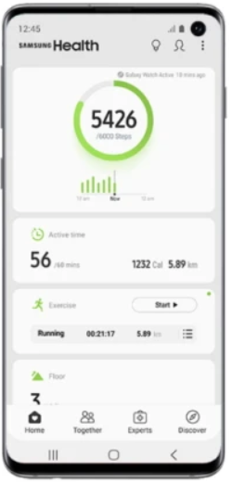



SW Size Estimation
FUNCTION POINT ANALYSIS (FPA)
The first step in calculating FP is to identify the counting boundary.
Counting boundary: The border between the application or project being measured and external applications or the user domain.
A boundary establishes which functions are included in the function point count
Internal data
Internal logical files (ILFs)
Inputs
Outputs
External Inputs(EIs)
External Outputs(EOs)
Queries
External Queries(EQs)
Application boundary
Application boundary
External data
External Interface files (EIFs)
Other System
Other System

Slide 38
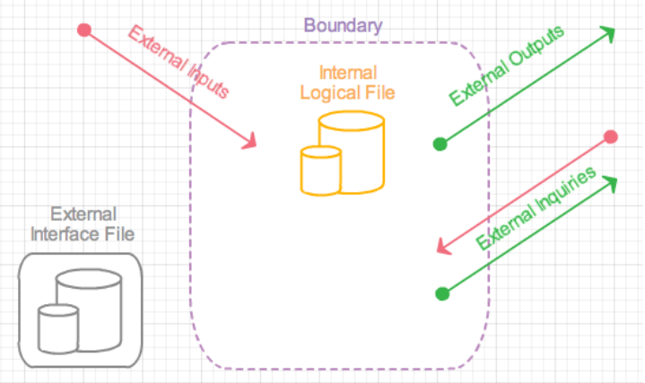
SW Size Estimation
Size Metric: FUNCTION POINT ANALYSIS (FPA)
Two data files/function types:
Internal Logical Files (ILF): This is the set of data present within the system. The majority of the data will be interrelated and are captured via the inputs received from the external sources.
External Interface Files(EIF): represent the data that your application will use/reference, but data that is not maintained by your application.
Three Transaction types:
External Inputs (EI): these are end-user actions such as putting in a login or executing a mouse click.
External Outputs (EO): the system provides the end-user output or interface such as a GUI display or items in a report.
External Inquiries (EQ): this function is initiated by the end-user. For example, the end-user wishes to submit a query to a database or requests on-line help. In any case the developer provides a means for the end-user to "search" for answers.

Slide 39
SW Size Estimation
Size Metric: FUNCTION POINT ANALYSIS (FPA)
Based on the data function complexity weight is assigned to each data function
Measurement Parameter | Low | Average | High
1. external inputs (EI) | 3 | 4 | 6
2. external outputs (EO) | 4 | 5 | 7
3. external inquiries (EQ) | 3 | 4 | 6
4. internal files (ILF) | 7 | 10 | 15
5. external interfaces (EIF) | 5 | 7 | 10
Count the number of all five components. The sum of each count is multiplied by an appropriate weight using Table above
Add all the five results calculated in the previous step. This is the final UFP.

Slide 40
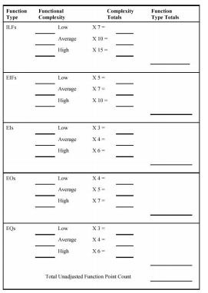

Slide 41
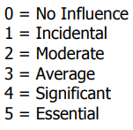
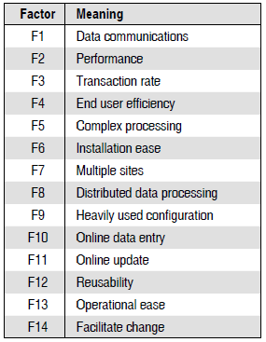
SW Size Estimation
Size Metric: FUNCTION POINT ANALYSIS (FPA)
Calculating Adjusted Function Point:
A value adjustment factor ( VAF) is used as a multiplier of the unadjusted function point (UFP) count in order to calculate the adjusted function point ( AFP) count of an application.
To calculate the VAF, we evaluate the 14 GSCs(General system Characteristics) on a scale of 0–5 to determine the degree of influence(DI) for each GSC description.
Add the DIs for all 14 GSCs to produce the total degree of influence (TDI).
Use the TDI in the following equation to compute VAF.
VAF = (TDI × 0.01) + 0.065
The final adjusted function point is calculated as,
AFP = UFP × VAF

Slide 42
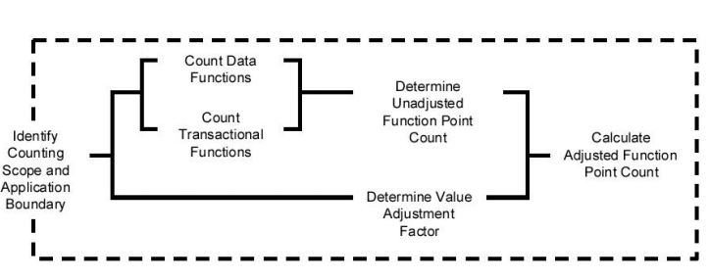
SW Size Estimation
FUNCTION POINT ANALYSIS (FPA)

Slide 43
SW Size Estimation
FUNCTION POINT ANALYSIS (FPA)
Example:
Consider a project with the following parameters: EI = 50, EO = 40, EQ = 35, ILF = 06, and ELF = 04. Assume all weighing factors are average. In addition, the system requires Significant performance, average end-user efficiency, moderate distributed data processing, and Significant data communication. Other GSCs are incidental. Compute the function points using FPA.

Slide 44
SW Development Life Cycle (SDLC)

Slide 45
SW Development Life Cycle (SDLC)
is a systematic process for building software that ensures the quality and correctness of the software built.
SDLC aims to produce high-quality software that meets customer expectations.

Slide 46
Why SDLC
It offers a basis for project planning, scheduling, and estimating
Provides a framework for a standard set of activities and deliverables
It is a mechanism for project tracking and control
Increases visibility of project planning to all involved stakeholders of the development process
Increased and enhance development speed
Improved client relations
Helps you to decrease project risk and project management plan overhead

Slide 47
SDLC Phases
Requirement Analysis
Feasibility
Design
Coding
Testing
Deploy
Maintenance
Phase 1: Requirement gathering and analysis
Phase 2: Feasibility
Phase 3: Design
Phase 4: Coding
Phase 5: Testing
Phase 6: Installation/Deployment
Phase 7: Maintenance

Slide 48
Requirement gathering and analysis
is one of the most critical phases of SDLC.
the basis of the whole software development process.
All the business requirements are gathered from the client in this phase.
Requirements are analyzed to prepare SW specification, A well defined document known as Software Requirement Specification (SRS).
is divided into two phases where requirement gathering is related to identify client’s projects technical requisites and the Analysis is to evaluate whether the accumulated information and facts are valuable enough to proceed with the project plan.

Slide 49
Requirement gathering and analysis
Why is the requirement gathering important?
is all about eliciting project requisites from client end so that they can get a full-fledged product embedded with all the specifications.
it helps all the project associates communicate effortlessly with each other over defined clients needs.
Who is responsible for requirements gathering?
Business Analysts are the professionals who efficiently carry out software requirement gathering by breaking down the critical technical specifications into effective documentation and user stories.

Slide 50
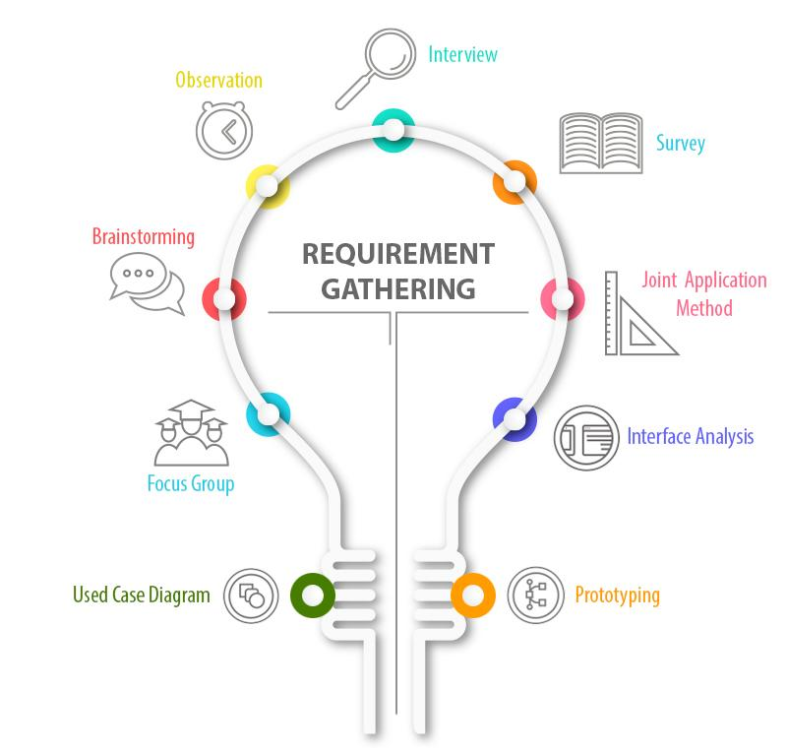
Requirement gathering and analysis
the business analyst talks to the user and clients who are unable to give out detailed information as they are not aware of the system development and related functionalities.
What are the tools and techniques of requirement gathering?
the responsible person observes the team in working environment and gets ideas about the software and subsequently document the observation.
Questionnaire delivered to the user as well as the stakeholder for answers.
subject matter experts are the responsible people to conduct brainstorming sessions. They discuss and find out solutions to complex issues.
all the stakeholders like developers, end users, business analysts and software engineers come together and attend workshops for working on a system in greater detail.
the idea is to collect information from representatives of clients and users to understand the software idea clearly.
Interface analysis is a specialized technique in which specific requirements related to application development are determined and their interaction with other software components is measured.
Use case diagram is a technique that shows how people interact with software. It shows what a system does.
building a model of software which helps in uncovering and capturing software requirements from client.

Slide 51
Requirement gathering and analysis
Challenges in Requirements Gathering
Lack of Clarity in Defining Criteria for Success
Clients Change their Minds Often
Lack of or Over Communication by Clients
Clients get stuck over certain Techniques/Solutions
Stakeholders can have Conflicting Priorities

Slide 52
Requirement gathering and analysis
You are business analyst of XYZ ltd. ABC bank wants to develop a mobile application of their banking products for their end users. Your company appointed you to collect the requirements for the mobile application from ABC Bank. What technique will you use to collect the requirement and what are the answers you need to get from your stakeholders??

Slide 53





Feasibility
Five types of feasibility check we need to perform
Operational
Can we create operations which is expected by the client?
03
Economic
01
Can we complete the project within the budget or not?
Technical
Need to check whether the current computer system can support the software
04
Legal
02
Can we handle this project as cyber law and other regulatory framework/compliances.
Schedule
Decide that the project can be completed within the given schedule or not.
05

Slide 54
Design
Design documents are prepared as per the SRS.
Helps to define overall system architecture.
There are two kinds of design documents developed in this phase:
High-Level Design (HLD)
Brief description and name of each module
An outline about the functionality of every module
Interface relationship and dependencies between modules
Database tables identified along with their key elements
Complete architecture diagrams along with technology details
Low-Level Design(LLD) / Detail Level Design (DLD)
Functional logic of the modules
Database tables, which include type and size
Complete detail of the interface
Addresses all types of dependency issues
Listing of error messages
Complete input and outputs for every module

Slide 55



Design
Why software design is important?
Modularity
When you have a modular software, it’s easy to move or even remove things if needed and even share the design work between multiple developers per software component.
Maintainability
With good software design it’s easier to maintain the software. You can spot straight away from the design how much a bug fix or introduction of a new feature will change the existing code base.
Performance
design should tell how your system works internally and how it uses resources such as threads, database connections and other things that might make a hit to the performance.
Portability
By including dependencies to other software modules, such as 3rd party libraries, in to your design makes the software much easier to port into another environment.
Usability
design works as a great starting point for new-comers. Instead of making them look through all the source files you can just point them to the software design where they find all information they’ll need to get started.
Trackability
Good design tracks the requirements and proves on the design level that all that is required from a piece of software is actually there..

Slide 56
Coding
developers start build the entire system by writing code using the chosen programming language.
tasks are divided into units or modules and assigned to the various developers.
is the longest phase of the Software Development Life Cycle process
developer needs to follow certain predefined coding guidelines
also need to use programming tools like compiler, interpreters, debugger to generate and implement the code.

Slide 57
Coding
Things which we need to take care in coding phase:
Version control
Before actual coding, you must spend sometime to select dev tool which will be suitable for debugging, coding, modification.
before actual writing code, some standard should be defined, as multiple developers going to use the same file for coding
during development, developer should write appropriate comments so that others will come to know the logic behind the code
there should be a regular review meeting need to conduct in this stage to identify the prospective defects in an early stage.

Slide 58
Testing
Focus on investigation and discovery
defines how the SW will be tested and who will perform
find whether the developed code work according to the customer requirement.
QA and testing team may find some bugs/defects which they communicate to developers.
development team fixes the bug and send back to QA for a re-test.
process continues until the software is bug-free, stable, and working according to the business needs of that system.

Slide 59
Installation/Deployment
Deployment is the process of promoting a fully-tested and approved application
QA manager finalized the final bug-free release items.
Deployment guide is provided to the operation team for hassle free deployment
Deployment could require different promotion processes
For web applications, it would require promoting the application to a server, testing, redirecting DNS
For standalone applications, it would require producing media or downloadable packages
For software as a service, there are licensing issues that need to be determined
Ensure data migration to the live server has occurred completely

Slide 60
Maintenance
Major Activities after SW deployment/while SW in use by the end users
Bug fixing
bugs are reported because of some scenarios which are not tested at all
maintenance
Upgrade
Upgrading the application to the newer versions of the Software
Enhancement
Adding some new features into the existing software
The main focus of this phase is to ensure that needs continue to be met and that the system continues to perform as per the specification mentioned in the first phase.

Slide 61
Why do we need a SW upgrade?

